Slide 1


Slide 2

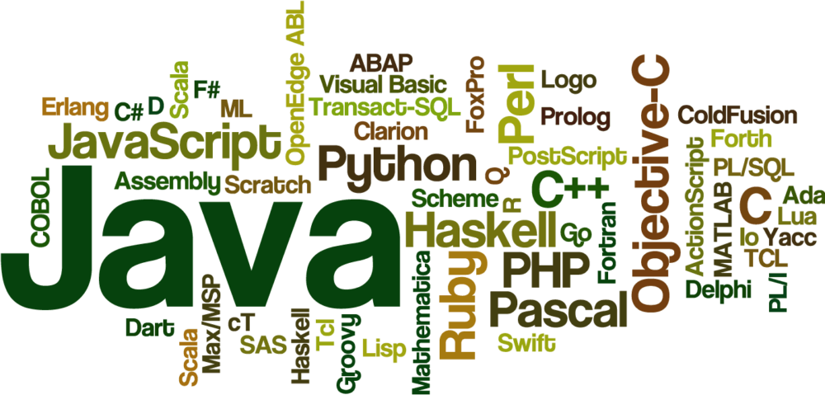


Slide 3



QUEUE
IN
JAVA

Slide 4
QUEUE IN JAVA:
A Queue is a First In First Out (FIFO) data structure.
The process of adding an element at the back of the Queue is called Enqueue.
The process of removing an element from the front of the Queue is called Dequeue.
Java provides a Queue interface which is part of Java’s collections framework.

Slide 5
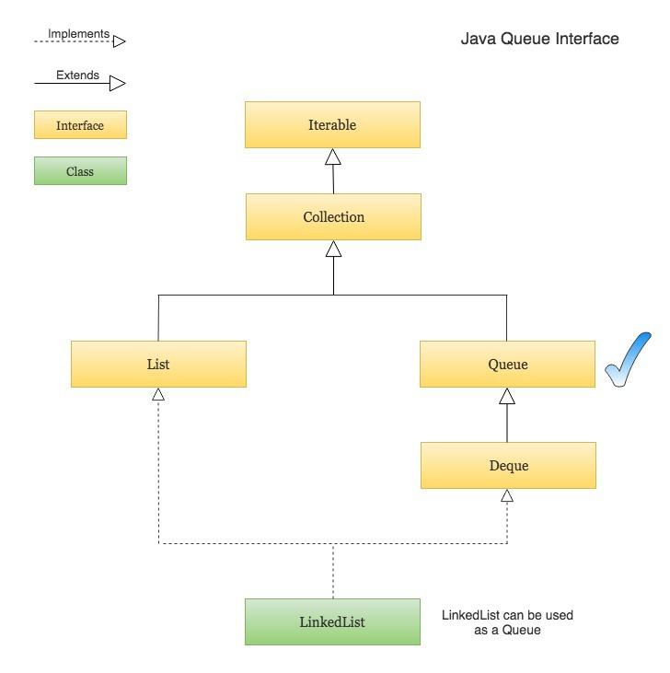
HIRERACHY:

Slide 6
NOTE
Queues typically, but do not necessarily, order elements in a FIFO (first-in-first-out) manner
Among the exceptions are priority queues, which order elements according to a supplied comparator, or the elements' natural ordering, and LIFO queues (or stacks) which order the elements LIFO (last-in-first-out)

Slide 7
NOTE
Queue implementations generally do not allow insertion of null elements, although some implementations, such as Linked List, do not prohibit insertion of null
Even in the implementations that permit it, null should not be inserted into a Queue, as null is also used as a special return value by the poll method to indicate that the queue contains no elements

Slide 8
PRIORITY QUEUE
An unbounded priority queue based on a priority heap
A priority queue does not permit null elements
A priority queue relying on natural ordering also does not permit insertion of non-comparable objects (doing so may result in ClassCastException)
The head of this queue is the least element with respect to the specified ordering

Slide 9
PRIORITY QUEUE
The queue retrieval operations poll, remove, peek, and element access the element at the head of the queue
A priority queue is unbounded, but has an internal capacity governing the size of an array used to store the elements on the queue
As elements are added to a priority queue, its capacity grows automatically

Slide 10
CONSTRUCTORS
PriorityQueue() | Creates a PriorityQueue with the default initial capacity (11) that orders its elements according to their natural ordering.
PriorityQueue​(int initialCapacity) | Creates a PriorityQueue with the specified initial capacity that orders its elements according to their natural ordering.
PriorityQueue​(Collection<? extends E> c) | Creates a PriorityQueue containing the elements in the specified collection.

Slide 11
METHODS IN QUEUE

Slide 12
add
boolean add(E e)
Parameters: e - the element to add
Returns: true (as specified by Collection.add(E))
Throws:
IllegalStateException - if the element cannot be added at this time due to capacity restrictions
ClassCastException - if the class of the specified element prevents it from being added to this queue

Slide 13
Contd…
NullPointerException - if the specified element is null and this queue does not permit null elements
IllegalArgumentException - if some property of this element prevents it from being added to this queue

Slide 14
offer
boolean offer(E e)
Inserts the specified element into this queue if it is possible to do so immediately without violating capacity restrictions.
Parameters: e - the element to add
Returns: true if the element was added to this queue, else false
Notes:
Throws:ClassCastException - if the class of the specified element prevents it from being added to this queue
NullPointerException - if the specified element is null and this queue does not permit null elements
IllegalArgumentException - if some property of this element prevents it from being added to this queue
remove

Slide 15
LOGIC
PriorityQueue<Integer> prq = new PriorityQueue<Integer>(); // add elements in queue for (int integer = 0; integer < 10; integer++) { prq.add(integer); } System.out.println("Initial Priority Queue Value : " + prq); // add element using offer() Function. prq.offer(153); System.out.println("Priority queue After offer() function :" + prq);
Notes:
nitial Priority Queue Value : [0, 1, 2, 3, 4, 5, 6, 7, 8, 9]
Priority queue After offer() function :[0, 1, 2, 3, 4, 5, 6, 7, 8, 9, 153]

Slide 16
Peek()
Priority_Queue.peek()
Parameters: The method does not take any parameters
Return Value: The method returns the element at the head of the Queue else returns NULL if the Queue is empty

Slide 17
LOGIC
PriorityQueue<String> queue = new PriorityQueue<String>(); // Use add() method to add elements into the Queue queue.add("Welcome"); queue.add("To"); queue.add("GREEN"); queue.add(“TRENDS"); queue.add("GRASH"); // Displaying the PriorityQueue System.out.println("Initial PriorityQueue: " + queue); // Fetching the element at the head of the queue System.out.println("The element at the head of the" + " queue is: " + queue.peek()); // Displaying the Queue after the Operation System.out.println("Final PriorityQueue: " + queue);
Notes:
Initial PriorityQueue: [TRENDS, GRASH, To, Welcome, GREEN]
The element at the head of the queue is: TRENDS
Final PriorityQueue: [TRENDS, GRASH, To, Welcome, GREEN]

Slide 18
Basic operations of priority queue

Slide 19
LOGIC
PriorityQueue<String> pQueue = new PriorityQueue<String>(); // Adding items to the pQueue using add() pQueue.add("C"); pQueue.add("C++"); pQueue.add("Java"); pQueue.add("Python"); // Printing the most priority element System.out.println("Head value using peek function:" + pQueue.peek()); // Printing all elements System.out.println("The queue elements:"); Iterator itr = pQueue.iterator(); while (itr.hasNext()) System.out.println(itr.next());
Notes:
Head value using peek function:C
The queue elements:
C
C++
Java
Python

Slide 20
LOGIC
// Removing the top priority element (or head) and // printing the modified pQueue using poll() pQueue.poll(); System.out.println("After removing an element" + "with poll function:"); Iterator<String> itr2 = pQueue.iterator(); while (itr2.hasNext()) System.out.println(itr2.next());
Notes:
After removing an elementwith poll function:
C++
Python
Java

Slide 21

THANK YOU

